Slide 1
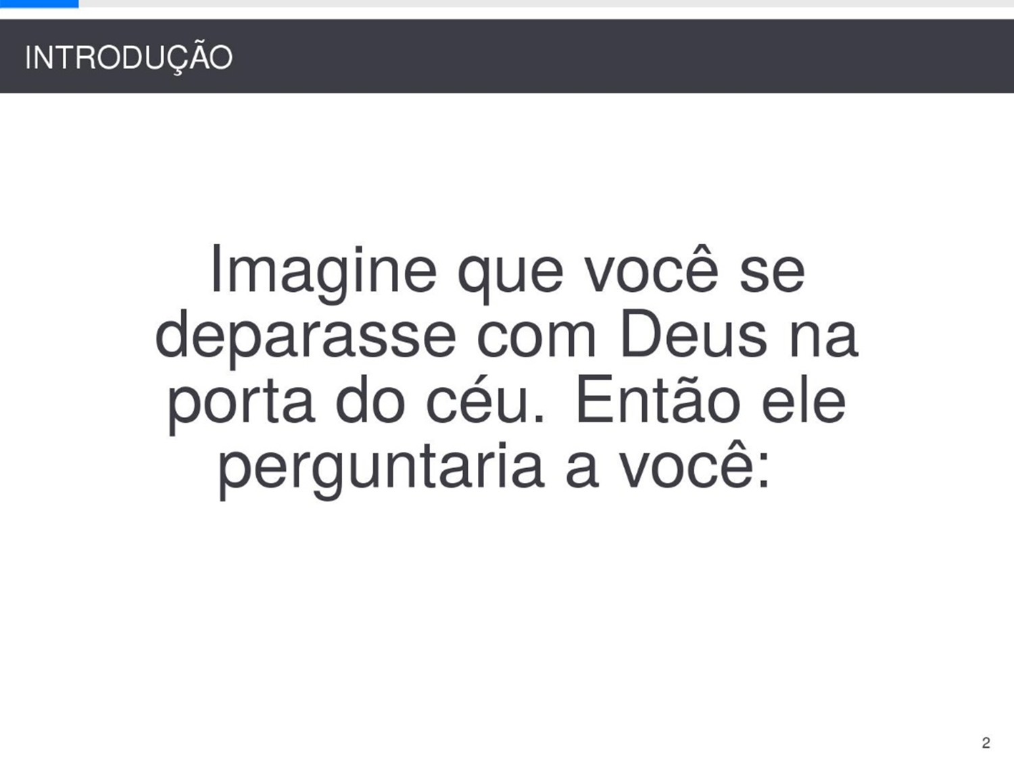
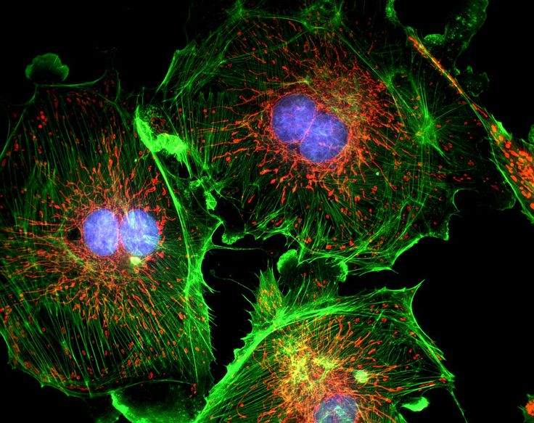
FPGA-based fluorescence microscope
Bring real time to multi-channel microscope
Yi Zhang Zhihao Yuan Tianzhi Wu

Slide 2
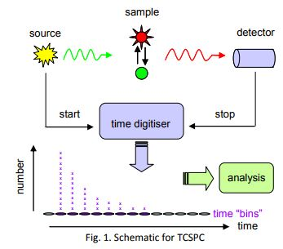
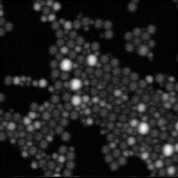
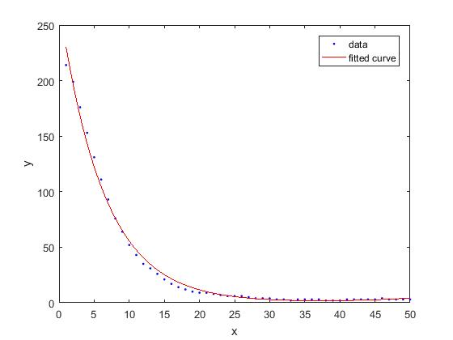
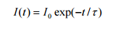
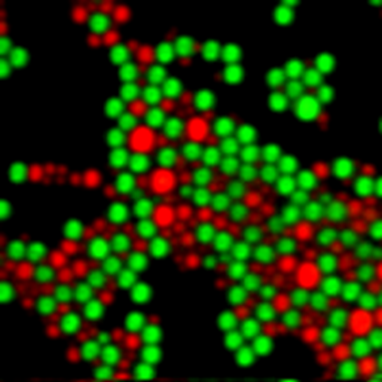
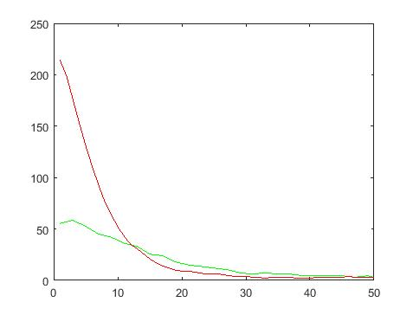
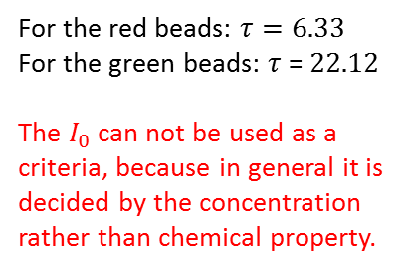
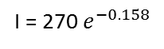
Goals and big picture
I = 270 $e^{−0.158}$
Fluorescence lifetime imaging
Amplitude
Fluorescence working principle
The decay curve can be described by exponential function.
For the red beads: $τ=6.33$
For the green beads: $τ$ = $22.12$
The $I_{0}$ can not be used as a criteria, because in general it is decided by the concentration rather than chemical property.
Time ns
Off-line processed by MATLAB
Different components have different lifetime
Our goal is separate different components based on fluorescence lifetime and display it.

Slide 3
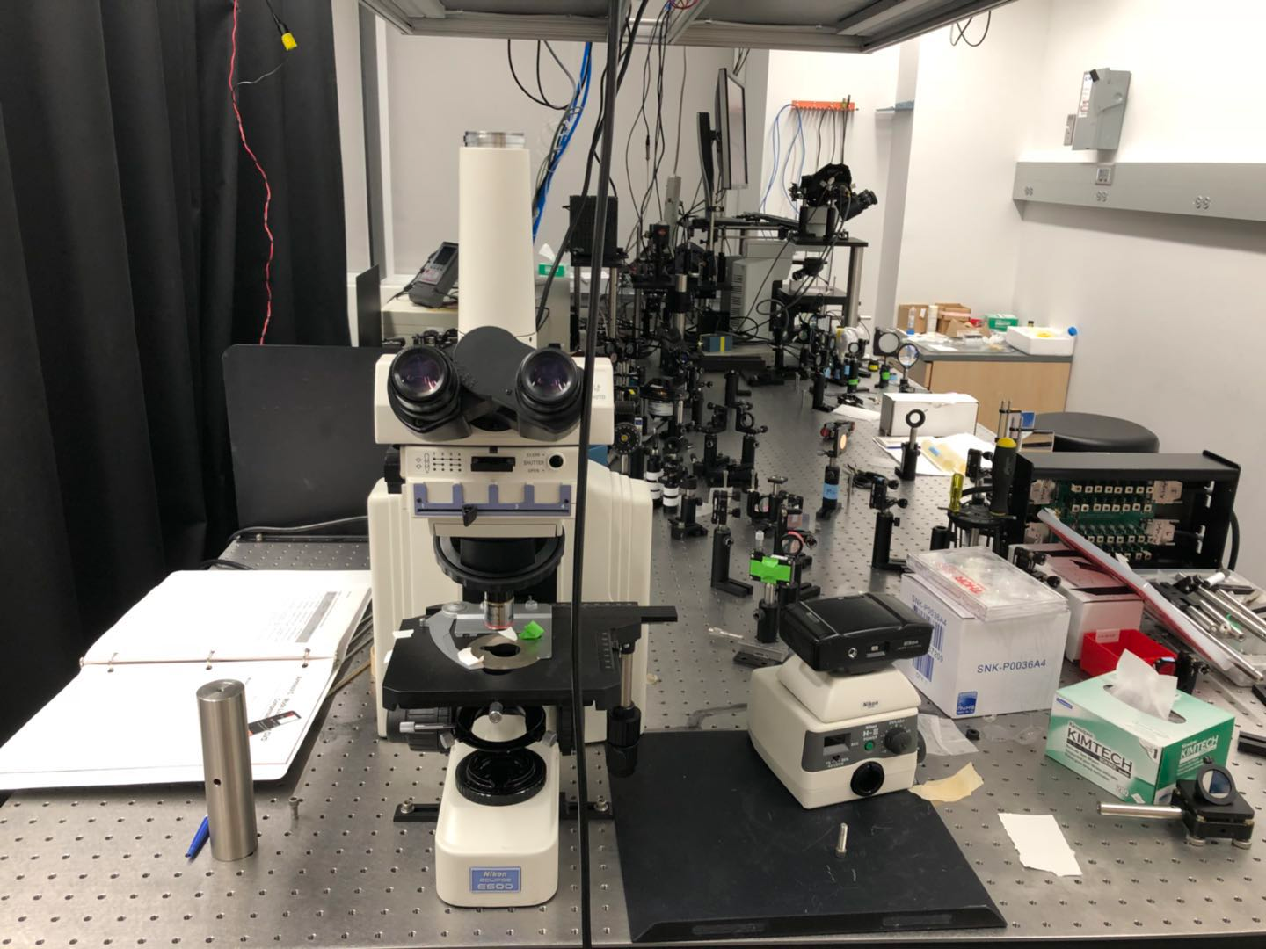
System Setup
monitor
VGA interface
We got the life time here
SD card
SD interface
Signal
Process
Classifier
&Pseudo color
Raw data Taken from Microscope is store here
FPGA
Display memory
Raw Data
DRAM
SRAM

Slide 4
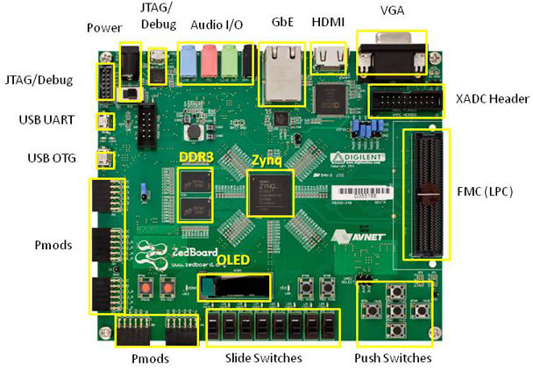
Zedboard induction
Zedboard contains a Zynq 7000 FPGA chip, which have a ARM processor core integrated.
This makes it possible to run C or C++ code on the FPGA board to implement some complex function like accessing SD card.

Slide 5
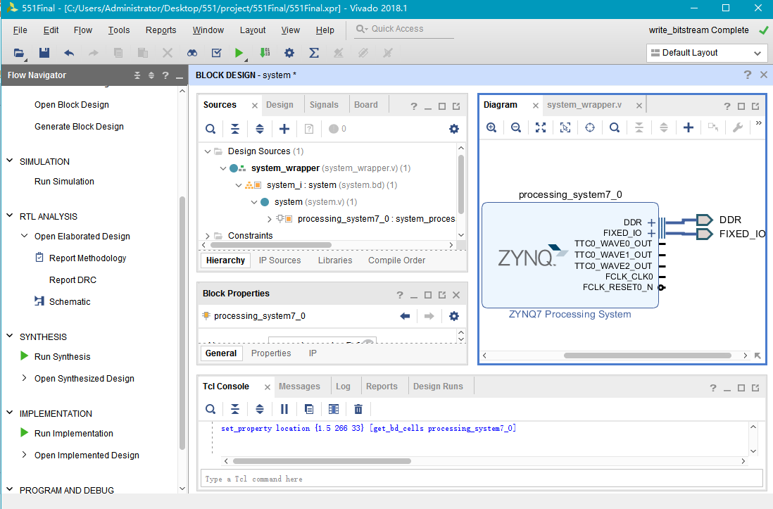
Programming Zedboard
To run C code on Zedboard, we will have to use Zynq core to build a hardware platform and setup inputs and outputs. Then we implementde the design and got a bitstream.
After that we import the bitstream and launch SDK.

Slide 6
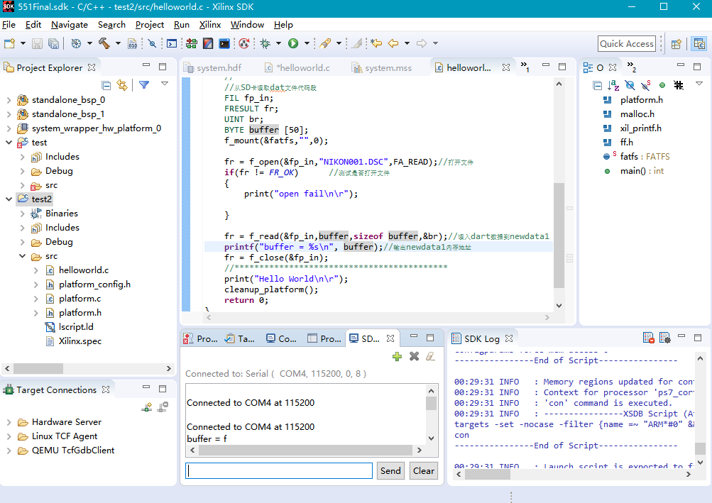
Programming Zedboard
Write C code and build and debug via SDK.
We use PROG port to program the board and receive the feedback from UART.

Slide 7
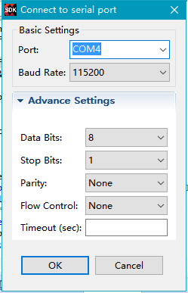
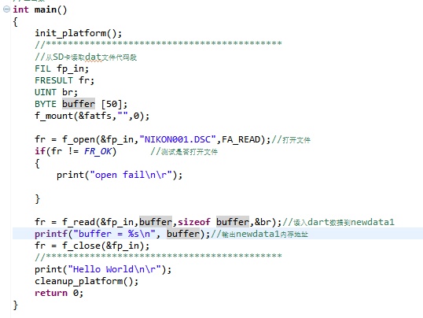
Programming Zedboard
Setup the connetion port.
Here is the simple code we used to read data from SD card.

Slide 8
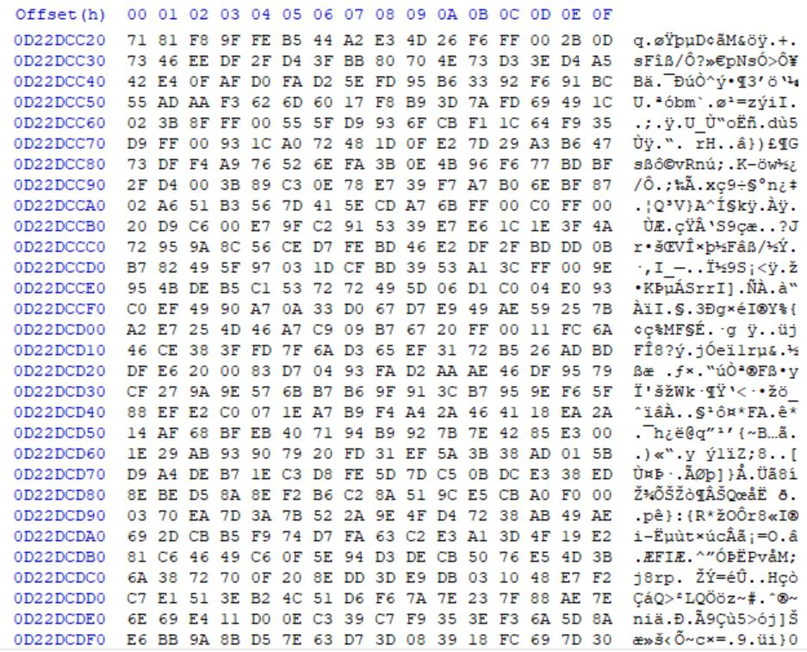
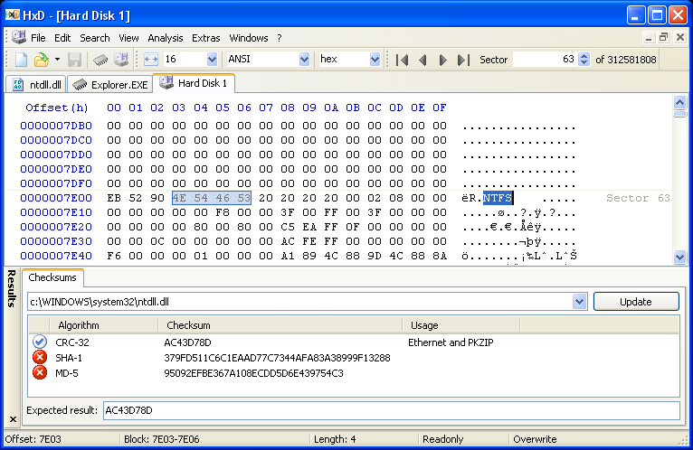
SD card operation
Data in sd card could be modified by HxD
SD Cards are block devices. That means you read/write data in multiples of the block size (usually 1024-bytes); the interface is basically "read from block address n", "write to block address m".

Slide 9
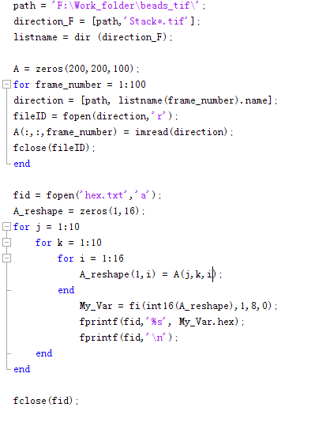
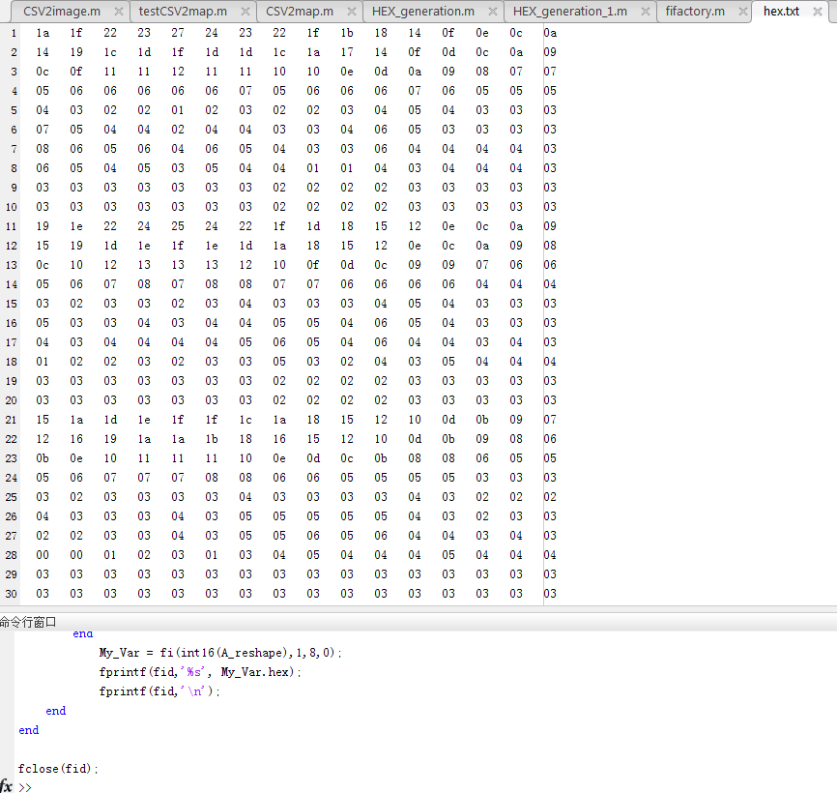
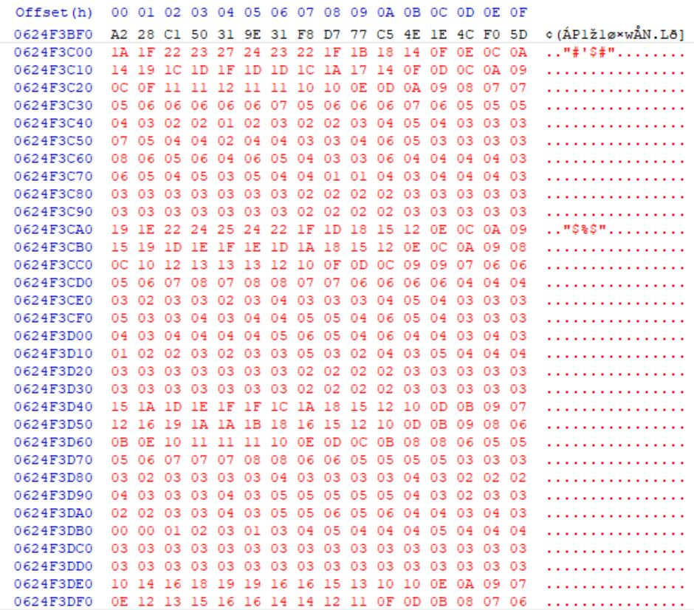
Write Raw image to SD card
The raw image could be read and processed to write to the SD card.
Written from Matlab to SD card
The amplitude of the fluorescence signal is between 255 and 1. So it can be represented by 2 hex numbers.

Slide 10
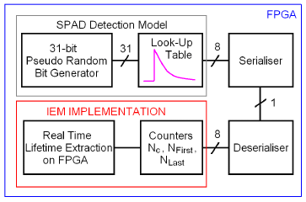
Signal Process
Classifier
&Pseudo color
The following digagram perfroms lifetime calculation for different material on FPGA.
The detection moel is replaced by SD card reader. And the Real Time Lifetime Extraction on FPGA will be perfromed as pseudo-color image on vga display.

Slide 11

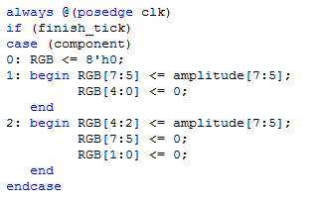
Pseudo-color
Verilog code
No components
Component 1
Amplitude 115
Component 2
Amplitude 87
VGA output:
If component 1, than first 3 bit of the amplitude
R: 3bit
G: 3bit
B: 2bit
If component 2, than first 3 bit of the amplitude
If do not belong to any component, RGB = 8’h00

Slide 12
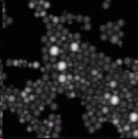
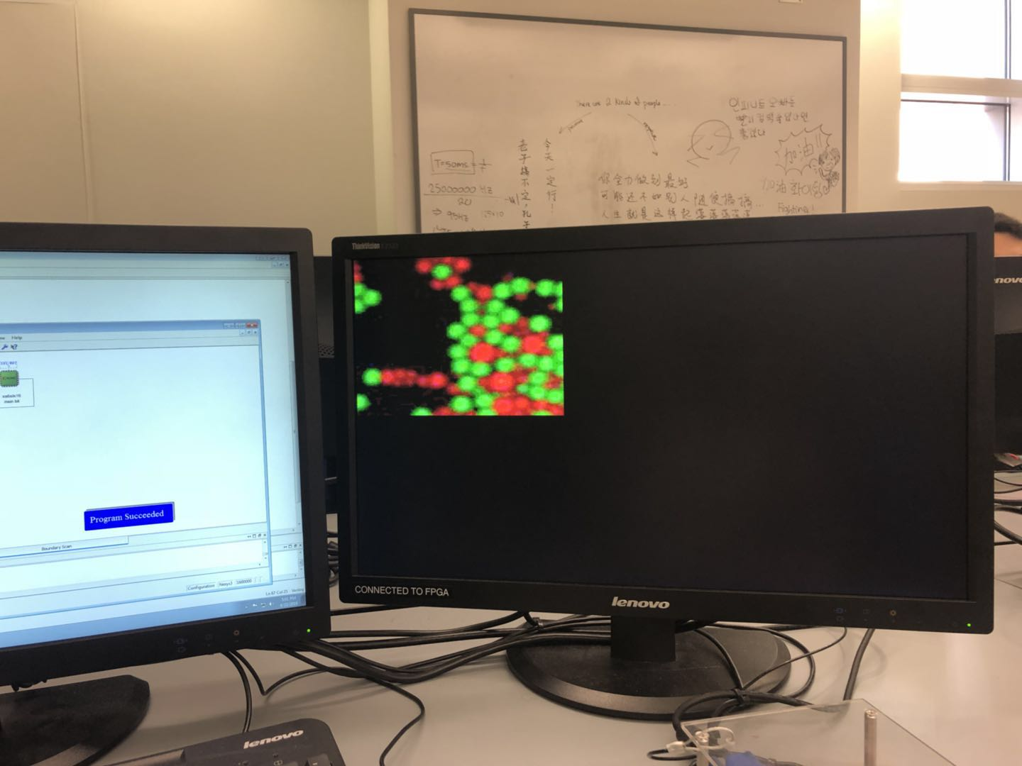
Finial results

Slide 13
Time line
Week/group member | 3/27-4/1 | 4/2-4/8 | 4/9-4/15 | 4/16-4/24
Yi Zhang | DRAM(done) | VGA interface(done) | VGA display and integrate with the system(done)
Tianzhi Wu | SD card(done) | SD- Card interface and SRAM connection(done) | Integrate with the system (done)
Zhihao Yuan | Signal Process(done) | Pseudo Color(done) | Classifier Integrate with System (done)
Group |  |  | Integration (done) | System test Process more data(done)

